Slide 1
Stock Price prediction
By Team Data Nerds

Slide 2
Team Data Nerds Mentor – Dr.John Basha chethan s Pandit – 19btrct002 M R Naveen Kumar – 19Btrcr005 Sushil Bokade – 19BTRCR017 A Rishab Vanigotha – 19BTRCR018

Slide 3
Abstract
Predicting stock returns accurately is a very difficult task due to the volatile and non-linear nature of financial stock markets.
With the advent of artificial intelligence and increased computing power, programmed prediction methods have proven more effective in predicting stock prices.
This project aims to build a model using Recurrent Neural Networks (RNN) and especially Long-Short Term Memory model (LSTM) with technical analysis to predict future stock market values.

Slide 4
Introduction
MARKET
According to data from the National stock exchange (NSE), there are 1.2 crore active investors in India, a country of 138 crore people, as of August 2021.
value
The value of stock groups is computed with high market capitalization. There are different technical parameters to obtain statistical data from the value of stock prices.
Model
The stock values are generally dynamic, non-parametric, and non-linear; therefore, they often cause the weak performance of the statistical models and disability to predict the accurate values and movements.
To-do
This project is proposing a method for Stock Price Prediction and to identify trend of each stock with help of technical indicators.

Slide 5
Problem statement
Every day, the stock market makes headlines. Every time it reaches a new high or low, you hear about it.
If an efficient algorithm for predicting the short-term price of an individual stock could be developed, the rate of investment and business opportunities in the stock market could increase.
Previous stock prediction methods included the use of Artificial Neural Networks and Convolution Neural Networks, which have an average error loss of 20%.
In this report, we will investigate the feasibility of developing a model using Recurrent Neural Networks and Technical analysis to predict stock price with a lower percentage of error.

Slide 6
Methodology
There are various models available for predicting the price of stock market such as Supervised model and Deep learning models.
When a market is in up or down trend we can use supervised learning models like
Linear regression - It shows linear relationship between dependent and independent variables.
Support Vector Regression - Support Vector Regression is a supervised learning algorithm that is used to predict discrete values. In SVR, the best fit line is the hyperplane that has the maximum number of points
Decision trees – It forms a tree like structure to solve regression problem. Decision trees regression normally use mean squared error (MSE) to decide to split a node in two or more sub-nodes.
But most of the time market don’t be in a trend moreover it will be volatile or a ranging market.
For such cases we are going to use deep learning model i.e., LSTM in RNN with technical indicators.
Long Short Term Memory Network is an advanced RNN, a sequential network, that allows information to persist. It is capable of handling the vanishing gradient problem faced by RNN.

Slide 7
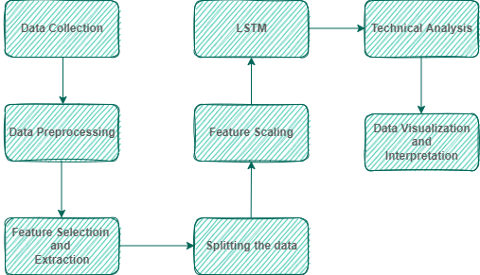
Work flow

Slide 8
Working of rnn
The input layer 'x' receives and analyses the neural network's input before passing it on to the middle layer.
Multiple hidden layers can be found in the middle layer 'h,' each having its own activation functions, weights, and biases.
You can utilize a recurrent neural network if the various parameters of different hidden layers are not affected by the preceding layer, i.e. the neural network does not have memory.
The different activation functions, weights, and biases will be standardized by the Recurrent Neural Network such that each hidden layer has the same characteristics.
Then, rather than producing numerous hidden layers, it will generate only one and loop over it as many times as necessary.

Slide 9

Working of lstm
LSTMs are a type of recurrent neural network, but instead of simply feeding its outcome into the next part of the network, an LSTM does a bunch of math operations so it can have a better memory.
An LSTM has four “gates”: forget, remember, learn and use(or output)
The long-term info goes into the forget gate, where, shocker, some of it is forgotten (the irrelevant parts).
The short-term info and “E” go into the learn gate. This gate decides what info will be learned. information that passes the
Forget gate -it is not forgotten, forgotten info stays at the gate and info that passes
Learn gate - it is learned will go to the remember gate
Remember gate - which makes up the new long term memory and
Use gate - which updates short term memory + is the outcome of the network.

Slide 10
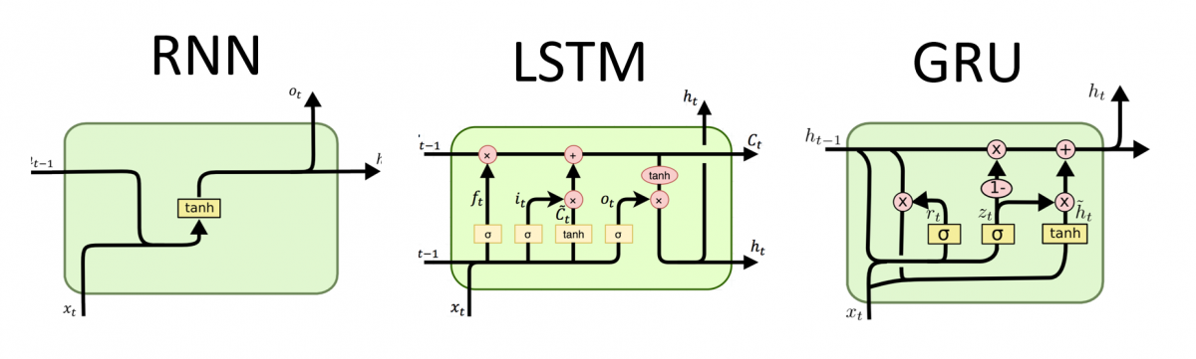
Why only LSTM?
RNNs have feedback loops in the recurrent layer. This lets them maintain information in ‘memory’ over time.
But, it can be difficult to train standard RNNs to solve problems that require learning long-term temporal dependencies.
This is because the gradient of the loss function decays exponentially with time (called the vanishing gradient problem).
LSTMs deal with vanishing and exploding gradient problem by introducing new gates, such as input and forget gates, which allow for a better control over the gradient flow and enable better preservation of “long-range dependencies”.
The long range dependency in RNN is resolved by increasing the number of repeating layer in LSTM.

Slide 11
Pros and cons of lstm
Advantages
Disadvantages
No feature engineering
No character segmentation
Learns temporal relationships
Fast evaluation
LSTM are well-suited for Time Series data
Very slow training time (1-2 days)
Not very interpretable
Drop outs is much harder to implement in LSTM
It requires more memory to train
Easy to overfit

Slide 12
conclusion
In this presentation we have gone through various methodologies and found that LSTM outperforms all other Supervised and Deep Learning models. Stock market is a time series data, So, we’re using LSTM which is used for time-series problem. Technical Analysis provides various momentum indicators, supporting LSTM to predict and analyze the future trend of the market. we have got to know that LSTM enable RNN to remember inputs for a long time as LSTM uses the memory.

Slide 13
Refrences
Atsalakis GS, Valavanis KP. Forecasting stock market short-term trends using a neuro-fuzzy based methodology. Expert Syst Appl. 2009;36(7):10696–707.
Ayo CK. Stock price prediction using the ARIMA model. In: 2014 UKSim-AMSS 16th international conference on computer modelling and simulation. 2014. https://doi.org/10.1109/UKSim.2014.67.
Brownlee J. Deep learning for time series forecasting: predict the future with MLPs, CNNs and LSTMs in Python. Machine Learning Mastery. 2018. https://machinelearningmastery.com/time-series-prediction-lstm-recurrent-neural-networks-python-keras/
Eapen J, Bein D, Verma A. Novel deep learning model with CNN and bi-directional LSTM for improved stock market index prediction. In: 2019 IEEE 9th annual computing and communication workshop and conference (CCWC). 2019. pp. 264–70. https://doi.org/10.1109/CCWC.2019.8666592.

Slide 14
Any queries?

Slide 15
THANK YOU

